Slide 1
DataBase Management System Lab (4CS4-22) Experiment No. -6 21-5-2021(Saturday) Topic to be covered : Joins(inner, left, right, full, self)

Slide 2
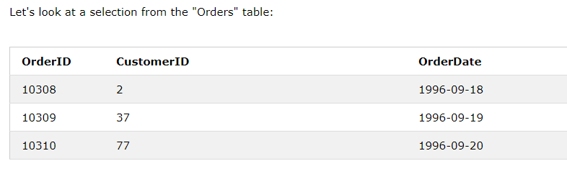
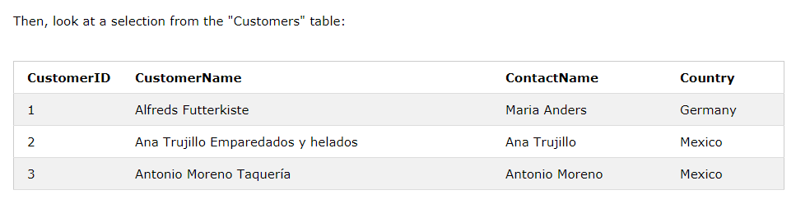
SQL JOIN
A JOIN clause is used to combine rows from two or more tables, based on a related column between them.

Slide 3
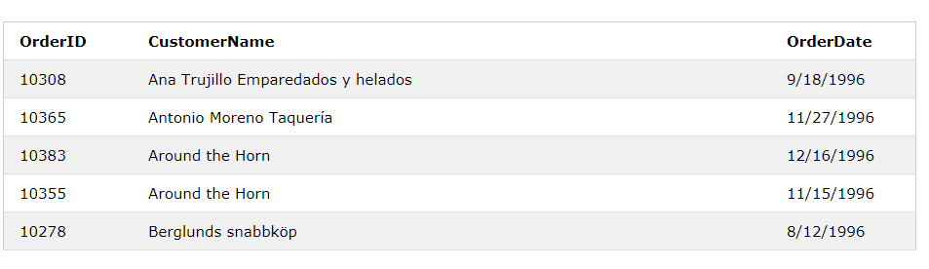
the "CustomerID" column in the "Orders" table refers to the "CustomerID" in the "Customers" table.
we can create the following SQL statement (that contains an INNER JOIN), that selects records that have matching values in both tables:
SELECT Orders.OrderID, Customers.CustomerName, Orders.OrderDate FROM Orders INNER JOIN Customers ON Orders.CustomerID=Customers.CustomerID;

Slide 4
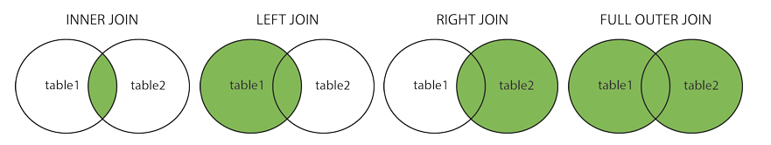
Different Types of SQL JOINs:
Here are the different types of the JOINs in SQL:
(INNER) JOIN: Returns records that have matching values in both tables
LEFT (OUTER) JOIN: Returns all records from the left table, and the matched records from the right table
RIGHT (OUTER) JOIN: Returns all records from the right table, and the matched records from the left table
FULL (OUTER) JOIN: Returns all records when there is a match in either left or right table

Slide 5
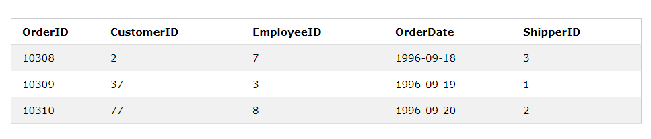
SQL INNER JOIN Keyword
The INNER JOIN keyword selects records that have matching values in both tables.
INNER JOIN Syntax
SELECT column_name(s) FROM table1 INNER JOIN table2 ON table1.column_name = table2.column_name;

Slide 6
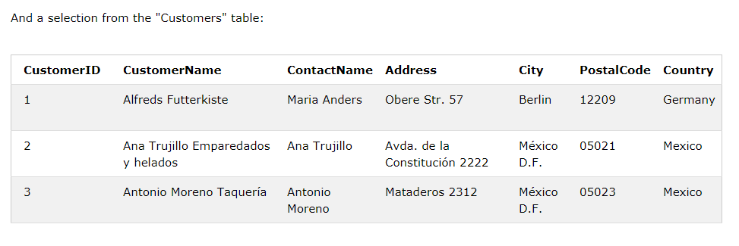
The INNER JOIN keyword selects all rows from both tables as long as there is a match between the columns. If there are records in the "Orders" table that do not have matches in "Customers", these orders will not be shown
Example:
SELECT Orders.OrderID, Customers.CustomerName FROM Orders INNER JOIN Customers ON Orders.CustomerID = Customers.CustomerID;

Slide 7
JOIN Three Tables
The following SQL statement selects all orders with customer and shipper information:
Example
SELECT Orders.OrderID, Customers.CustomerName, Shippers.ShipperName FROM ((Orders INNER JOIN Customers ON Orders.CustomerID = Customers.CustomerID) INNER JOIN Shippers ON Orders.ShipperID = Shippers.ShipperID);

Slide 8
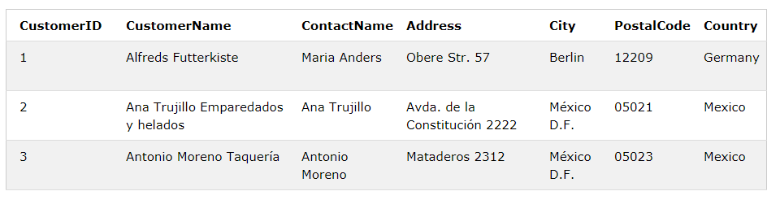
SQL LEFT JOIN Keyword
The LEFT JOIN keyword returns all records from the left table (table1), and the matching records from the right table (table2). The result is 0 records from the right side, if there is no match.
LEFT JOIN Syntax
SELECT column_name(s) FROM table1 LEFT JOIN table2 ON table1.column_name = table2.column_name;

Slide 9
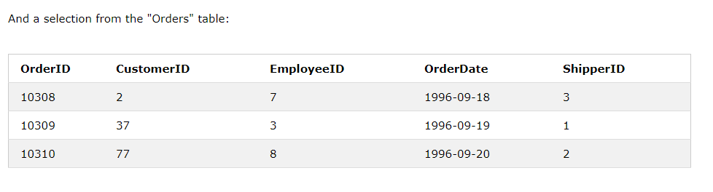
select all customers, and any orders they might have:
Example
SELECT Customers.CustomerName, Orders.OrderID FROM Customers LEFT JOIN Orders ON Customers.CustomerID = Orders.CustomerID ORDER BY Customers.CustomerName;
The LEFT JOIN keyword returns all records from the left table (Customers), even if there are no matches in the right table (Orders).

Slide 10
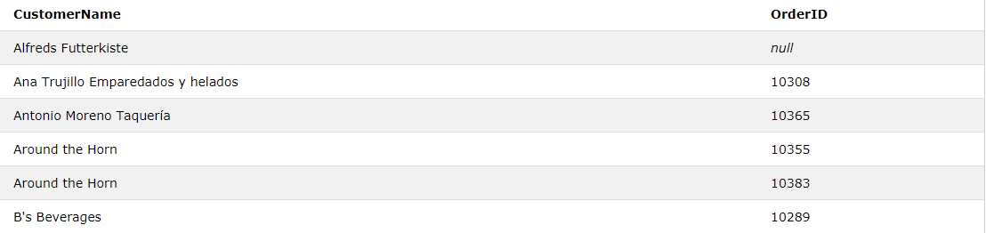

Slide 11
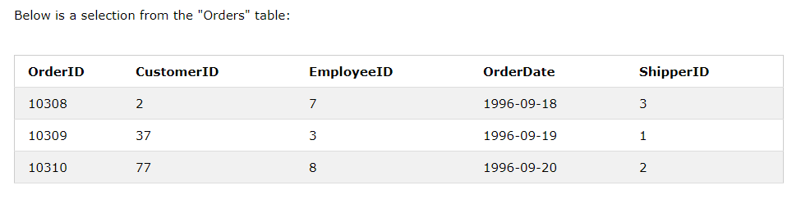
SQL RIGHT JOIN Keyword
The RIGHT JOIN keyword returns all records from the right table (table2), and the matching records from the left table (table1). The result is 0 records from the left side, if there is no match.
RIGHT JOIN Syntax
SELECT column_name(s) FROM table1 RIGHT JOIN table2 ON table1.column_name = table2.column_name;

Slide 12
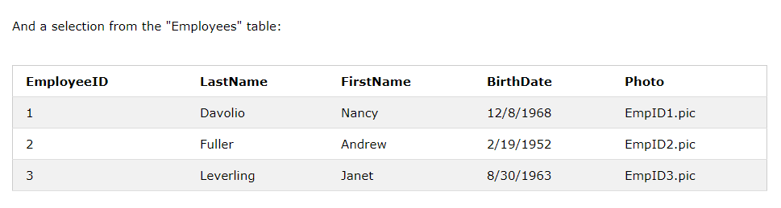
Example
Select all employees, and any orders they might have placed:
SELECT Orders.OrderID, Employees.LastName, Employees.FirstName FROM Orders RIGHT JOIN Employees ON Orders.EmployeeID = Employees.EmployeeID ORDER BY Orders.OrderID;
The RIGHT JOIN keyword returns all records from the right table (Employees), even if there are no matches in the left table (Orders).

Slide 13
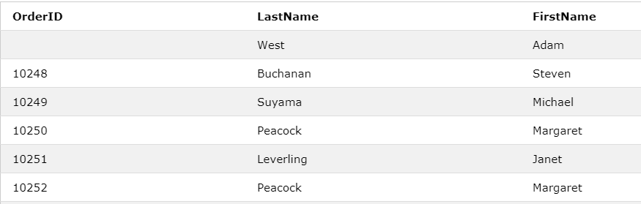

Slide 14
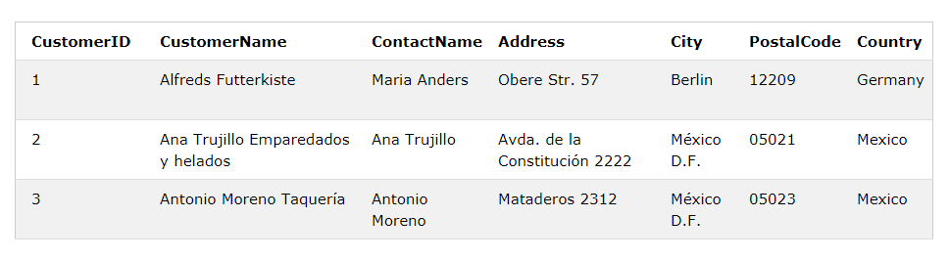
SQL FULL OUTER JOIN Keyword
The FULL OUTER JOIN keyword returns all records when there is a match in left (table1) or right (table2) table records.
FULL OUTER JOIN Syntax
SELECT column_name(s) FROM table1 FULL OUTER JOIN table2 ON table1.column_name = table2.column_name WHERE condition;

Slide 15
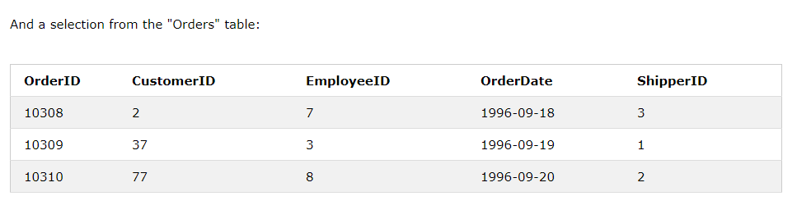
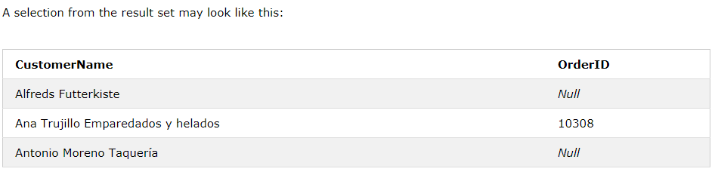
SQL FULL OUTER JOIN Example
selects all customers, and all orders
SELECT Customers.CustomerName, Orders.OrderID FROM Customers FULL OUTER JOIN Orders ON Customers.CustomerID=Orders.CustomerID ORDER BY Customers.CustomerName;

Slide 16
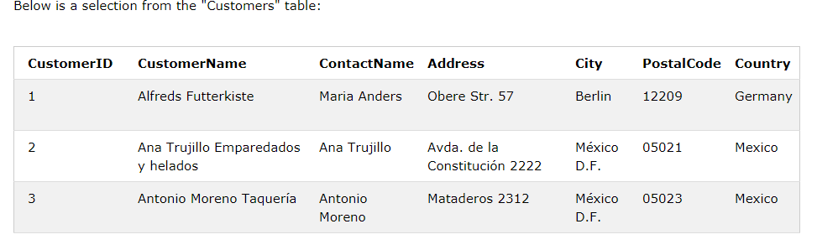
SQL Self Join:
A self join is a regular join, but the table is joined with itself.
Self Join Syntax
SELECT column_name(s) FROM table1 T1, table1 T2 WHERE condition;
T1 and T2 are different table aliases for the same table.

Slide 17
Don’t write next slide in Lab record further slides only for understanding

Slide 18
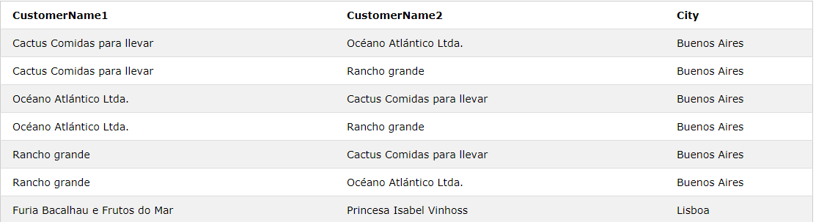
SQL Self Join Example
The following SQL statement matches customers that are from the same city:
Example
SELECT A.CustomerName AS CustomerName1,B.CustomerName AS CustomerName2, A.City FROM Customers A, Customers B WHERE A.CustomerID <> B.CustomerID AND A.City = B.City ORDER BY A.City;

Slide 19
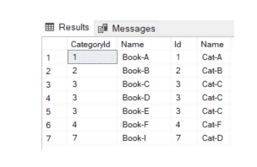
INNER JOIN:
Let’s retrieve the values for the CategoryId and Name columns from the Books table, and the Id and Name columns from the Categories table, where the values for the CateogryId column of the Books table and the Id column of the Categories table are the same:
SELECT Books.CategoryId, Books.Name, Categories.Id, Categories.Name
FROM Books
INNER JOIN Categories
ON Books.CategoryId = Categories.Id
You can see that from the Books table, the records for the books with CategoryId of 5 are not being displayed since the Id column of the Categories table doesn’t contain 5. Similarly, from the Categories tables, categories with the Id value of 8, 10, 12, and 16 are not being displayed since the CateogryId column from the Books table doesn’t contain these values.

Slide 20
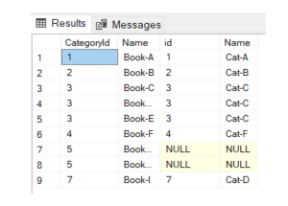
LEFT JOIN:
if you apply a LEFT JOIN on the CategoryId column of the Books table and the Id column of the Categories table. All the records from the Books table (the table on the left) will be retrieved, whereas from the Categories table (the table on the right) only those records will be retrieved where the CategoryId column of the Books table and the Id column of the Categories table, have the same values.
SELECT Books.CategoryId, Books.Name, Categories.id, Categories.Name
FROM Books
LEFT JOIN Categories
ON Books.CategoryId = Categories.Id
From the result, you can see that all the records from the books table are displayed. For the id and Name columns of the Categories table, only the matching records are displayed. Since the Categories table doesn’t contain 5 in the Id column, NULL values have been added in the columns for the Categories table.

Slide 21
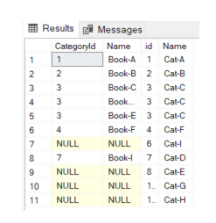
RIGHT JOIN
if you apply a RIGHT JOIN on the CategoryId column of the Books table and the Id column of the Categories table. All the records from the Categories table (the table on the right) will be retrieved, whereas from the Books table (the table on the left) only those records will be retrieved where the CategoryId column of the Books table and the Id column of the Categories table, have the same values.
SELECT Books.CategoryId, Books.Name, Categories.id, Categories.Name
FROM Books
RIGHT JOIN Categories
ON Books.CategoryId = Categories.Id
From the output, you can see that all the records from the Categories table columns are displayed. For the CategoryId and Name columns of the Books table, only the matching records are displayed. Since the Books table doesn’t contain any record with values 6, 8, 10, or 12, in the CategoryId column, NULL values have been added in the columns from the Books table.

Slide 22
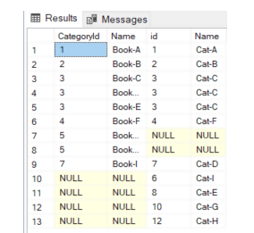
FULL JOIN
The FULL JOIN clause retrieves all the records from both the tables irrespective of the match between the values in the columns used in the FULL JOIN clause.
SELECT Books.CategoryId, Books.Name, Categories.id, Categories.Name
FROM Books
FULL JOIN Categories
ON Books.CategoryId = Categories.Id
The output shows that all the records have been retrieved from the Books and Categories tables. NULL values have been added for the rows where a match is not found between the CategoryId column of the Books table and the Id column of the Categories table.
SELECT * FROM books b LEFT OUTER JOIN categories c ON b.CategoryId=c.Id
UNION
SELECT * FROM books b RIGHT OUTER JOIN categories c ON b.CategoryId=c.Id;

